Slide 2
Network 360

Slide 3
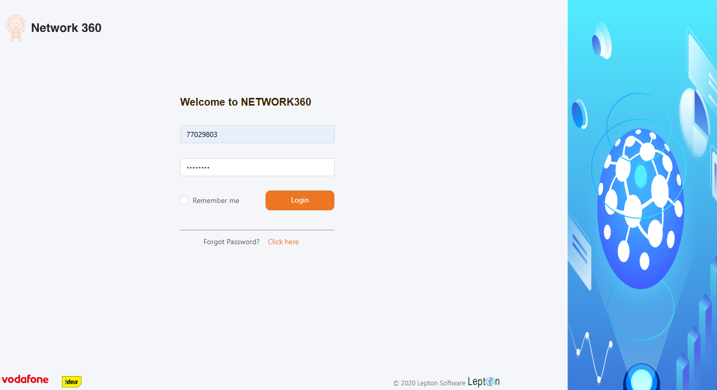
Login Page

Slide 4
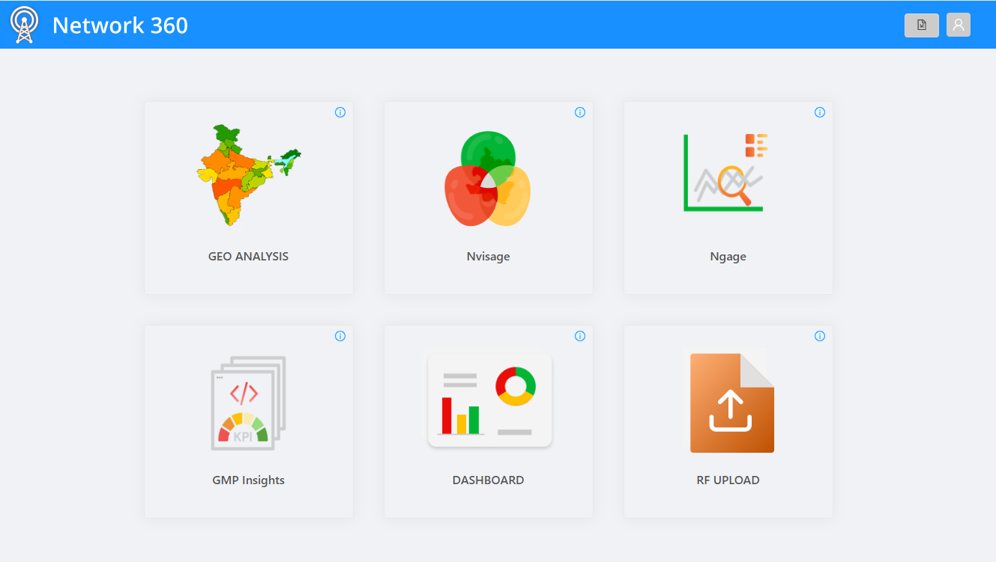
Home Page
GEO Analysis
Where you will able to fetch the details of the location
1

Slide 5
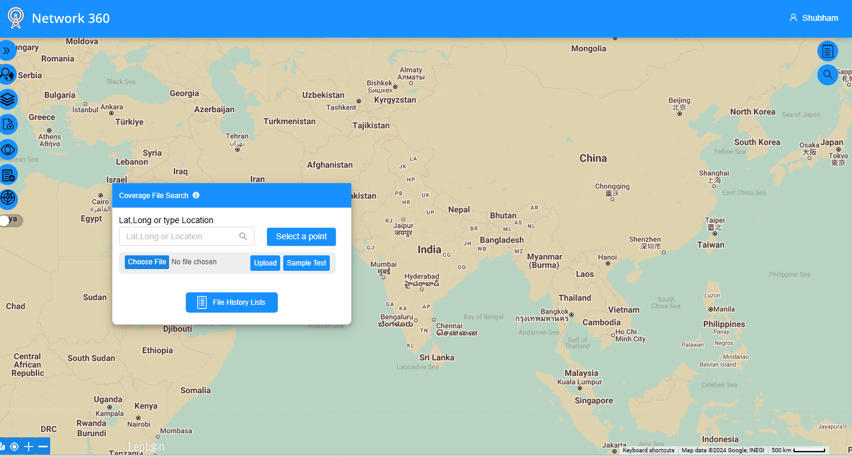
Searching Lat. Long Details
Searching the location Coverage button will be helpful
1

Slide 6
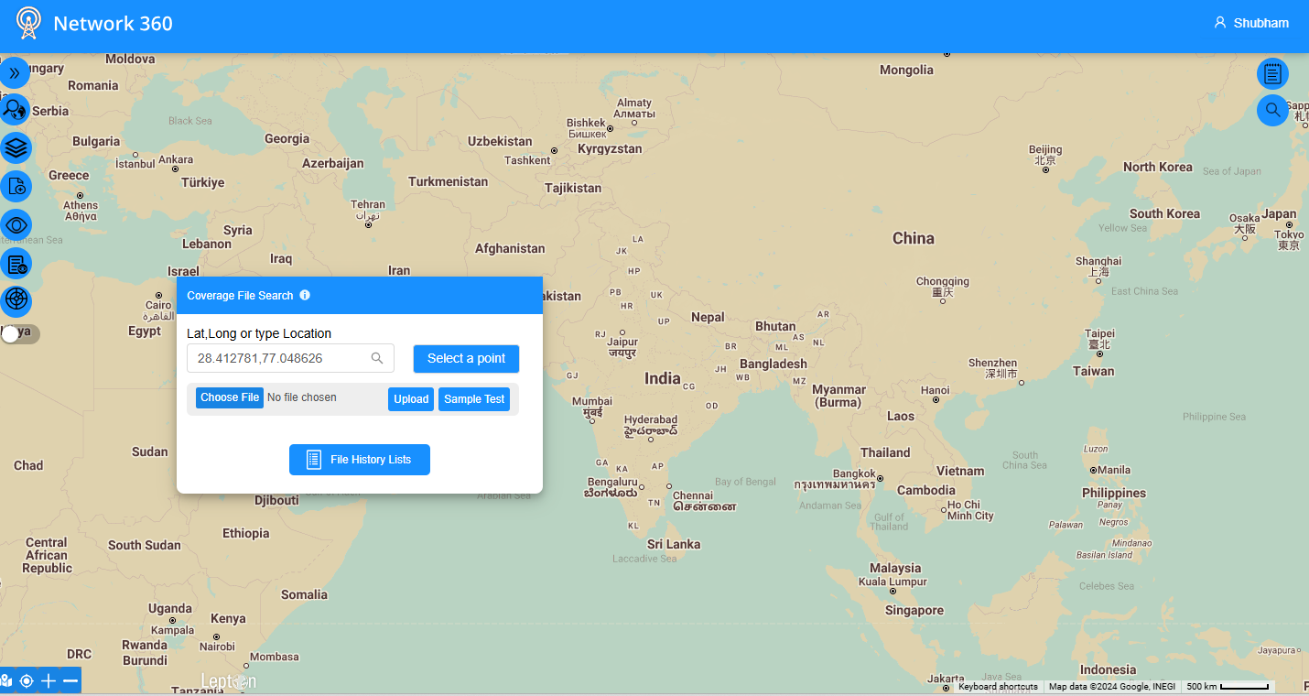
Searching Lat. Long Details
Enter the lat. Long. Details in highlighted format and then click on search ICON
1

Slide 7
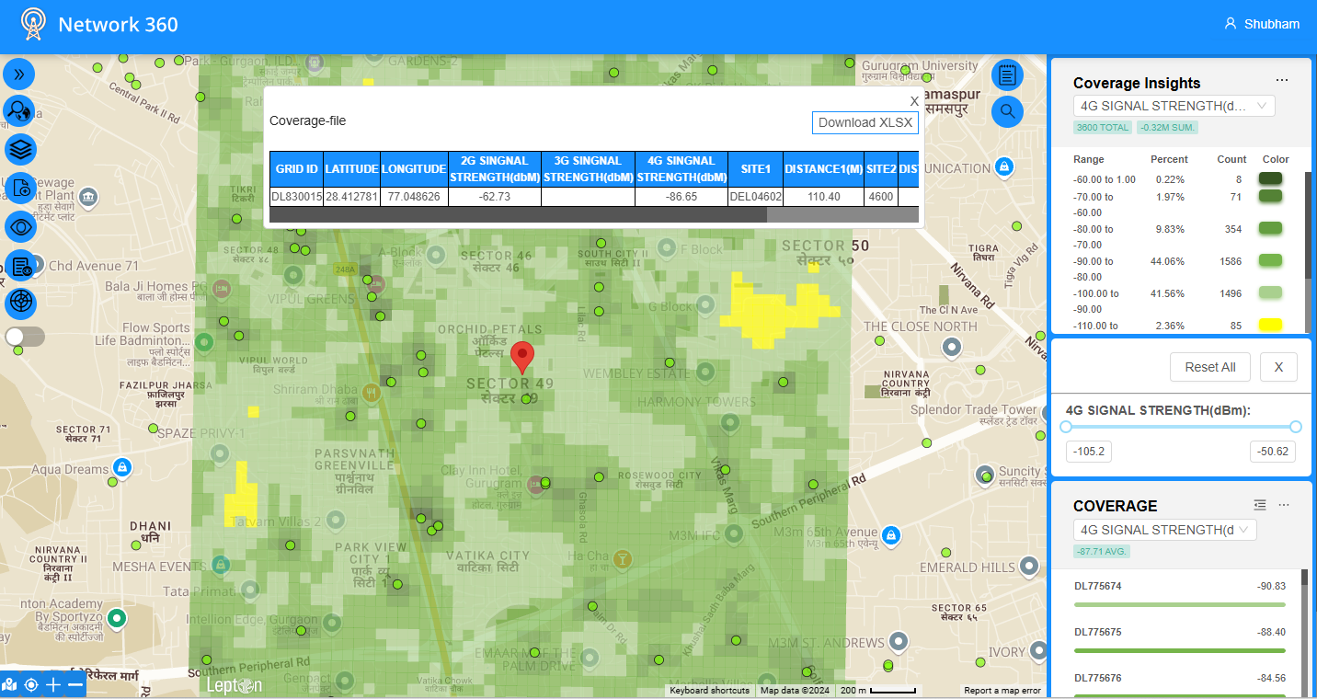
Location Details with Signal strength
1
You will see the signal strength for 2G, 3G, and 4G
You can also download the data from the download option.

Slide 8
Thank you !

